Slide 1
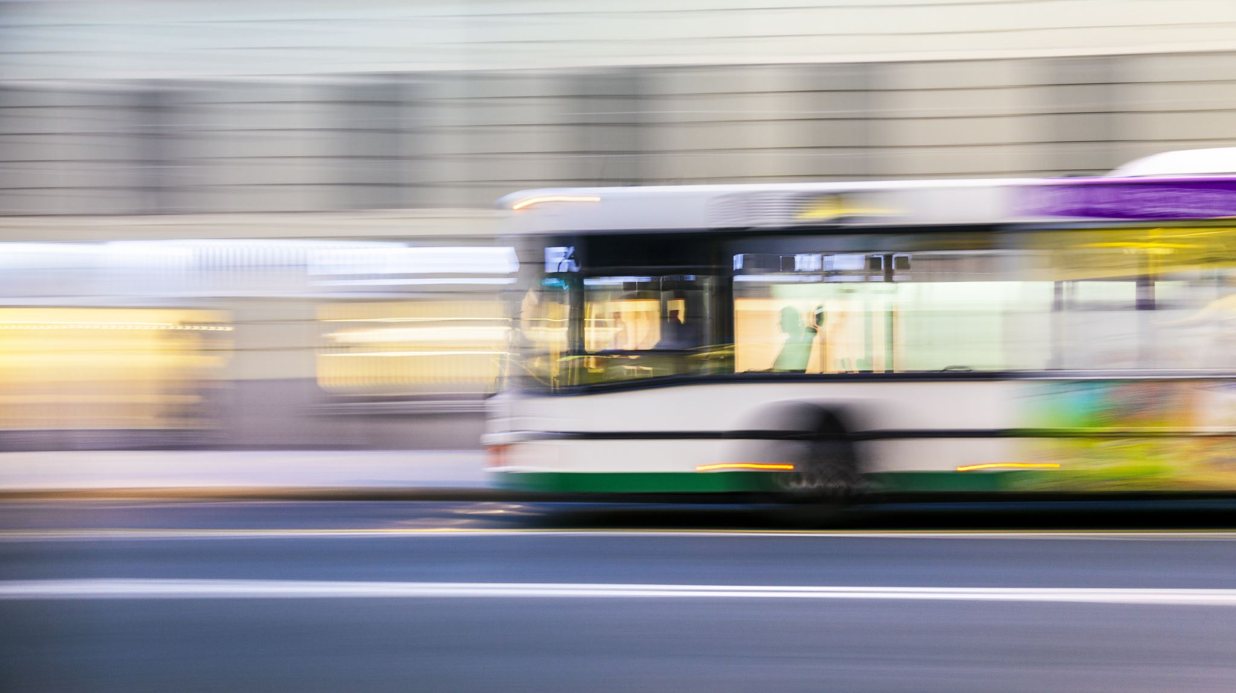
Transportation for an Aging Population in Burlington, VT
Amelia Luke, Autumn Strom,
Katie Alexander, & Krysta Gingue

Slide 2
Burlington and Transporation
Transportation Demand Management
Transportation accessibility should be all inclusive
From: https://mobilitylab.org/about-us/what-is-tdm/
Notes:
Transportation Demand Management focuses on understanding how people make their transportation decisions and helping people use the infrastructure in place for transit, ridesharing, walking, biking, and telework. It aims for cost-effective guidance in the design of transportation and physical infrastructure so that alternatives to driving are naturally encouraged and our systems are better balanced. The goal of our report was to find opportunities for diversification of modes in transportation in Burlington, VT. While our focus was on accessibility for aging populations, with further understanding of transportation initiatives, we soon found that accessibility aims should encompass all vulnerable populations for efficient and effective change.
Important to note is that transportation systems are complex and the Burlington and Vermont transportation organizations frequently yet inconsistently overlap, so while our group tried to distill this information into a digestible report and presentation, there will be many nuanced aspects of transportation accessibility in Burlington that we could not touch on. Thankfully, there are many capable organizations in the state that can be resources for addressing concerns about transportation for an aging population.

Slide 3
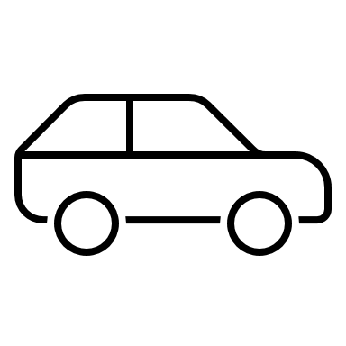
Methodology
Read through existing literature, which helped us to understand other cities’ initiatives.
Conducted four interviews with transportation stakeholders.
Based on this, we chose three transportation areas in Burlington to research and analyze.
Based on all this data, we created our recommendations for the Burlington Aging Council.
Notes:
Interviews: Jordan Posner, Jack Hanson, Gene Bergman, Jane Catton and Erica Marks. Interviewees were all asked a similar set of questions created by our group. We were looking to understand initiatives that were going well and learn about barriers that organizations face

Slide 4
Situation Analysis
2015 Transportation Demand Management Action Plan
2019 St. Paul Street Great Streets Project
2021 N. Winooski Corridor Plan
2022 TIF Bond Main St Great Streets Project
2020 UVMMC Bus Implementation
2021 Micro Transit Policy
Notes:
In addition to research on transportation alternatives in other cities, we conducted a situation analysis to identify opportunities and challenges present in the Burlington political landscape and define the scope of the problem for transportation management in the city. We analyzed 6 transportation programs and policies that took place in the last 7 years including, a 2015 TDM Action Plan report, the 2019 St. Paul Street and 2022 Main Street TIF Bond for the Great Streets project, the 2020 UVM Medical Center Private Bus system implementation, the North Winooski Corridor Project in 2022, and the 2021 State of Vermont Micro Transit policy and subsequent creation of GMT’s MyRide program. All of these projects sought to address outstanding infrastructure and transportation access issues in Burlington and Vermont but resulted in different impacts to the communities served. The situation analysis is a key feature of understanding the transportation field in Burlington and how public and private organizations and individuals exist in the transportation space. As we move forward with deeper analysis of transportation options in Burlington, it is vital to understand the policy implications of change and what is feasible in the current political climate.

Slide 5
From stakeholder interviews: Bus and "point-to-point" service need themes
Competing interest groups
Bus route expansion
Local cash-matching
Public-private partnerships (UVMMC)
Remove ride cap for medical appointments
Increased flexibility (micro transit)
Research generational transit needs

Slide 6
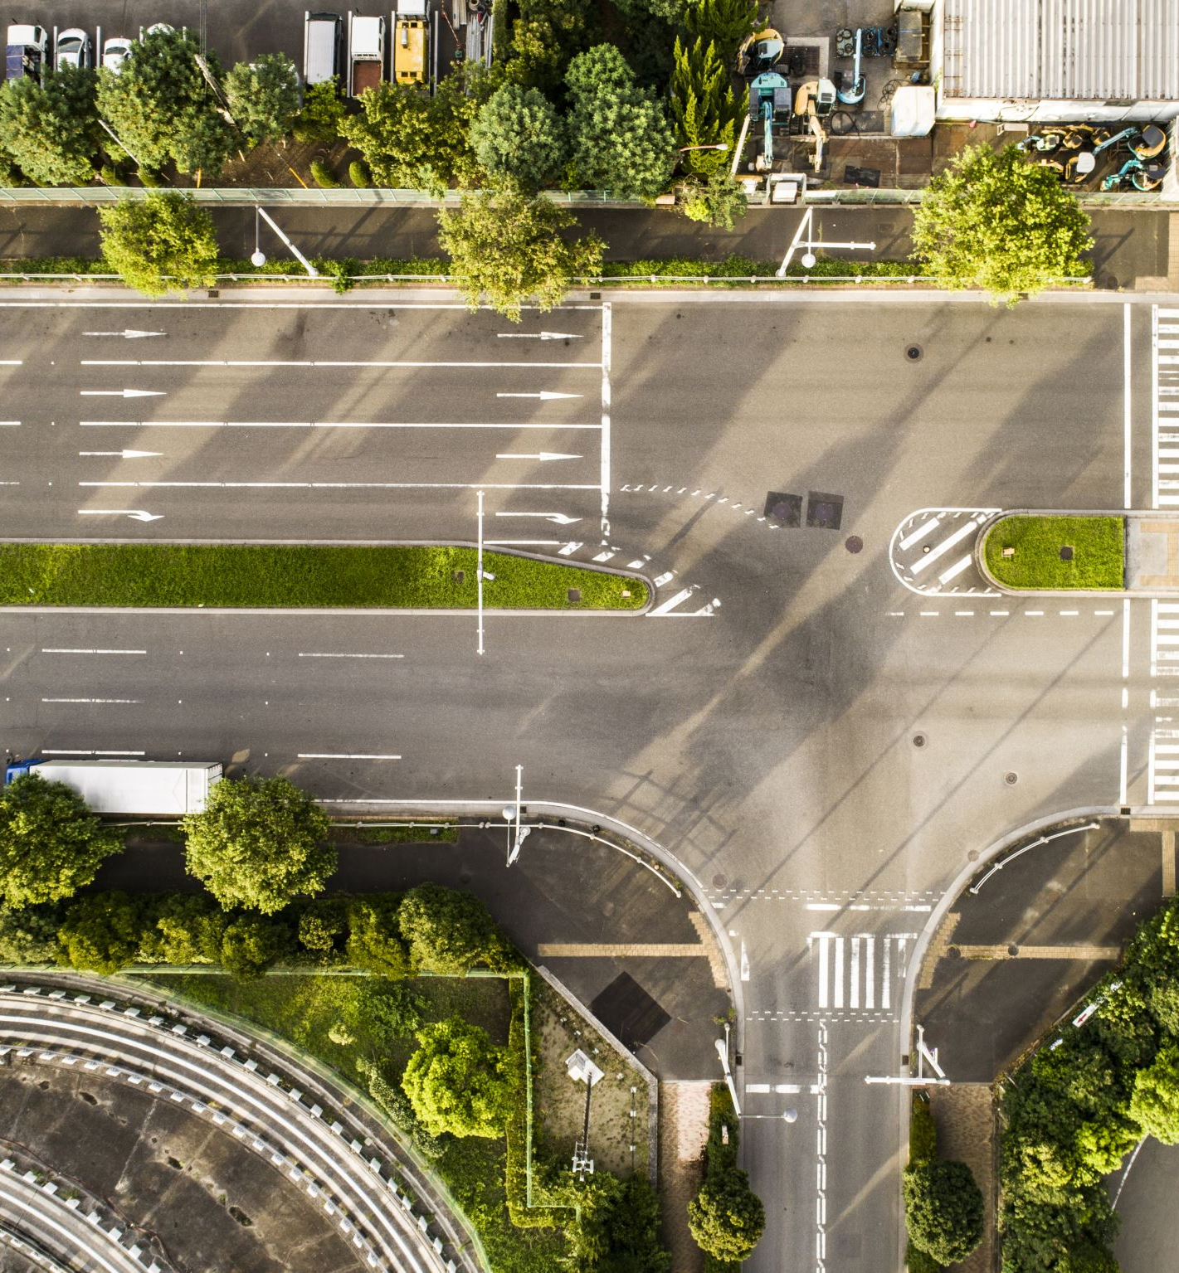
Infrastructure
Sidewalks
Quality ≄ quantity
Intersections and Crossings
Accessible pedestrian signals
Great Streets Plan
Walkable & Bikeable
Sustainable
Vibrant
Functional
Notes:
In 2018, AARP conducted a neighborhood walk audit with elderly residents in the Centennial neighborhood. Conditions of these streets to vary widely, and the group overall rated intersections and crossings as poor, and sidewalks as fair. “The city also has nearly 100 percent sidewalk coverage” according to Walk Friendly Communities, but having quantity does not translate to quality in terms of walkability.
For pedestrians, Intersections that are particularly dangerous would benefit from accessible pedestrian signals. Currently, these signals are not present at every major crosswalk. The ability to hear the audible "WALK NOW" improves the safety of those who are hard of hearing, and the flashing lights encourages drivers to slow down before they reach the intersection. Seniors could decide to walk more often if these increased safety improvements are met, but safety is not the only aspect that creates walkable neighborhoods.
Burlington is attempting to remedy this as one of its solutions in the Great Streets Plan. This initiative is an ongoing effort to rebuild downtown public streets in accordance with four values articulated by Burlington’s residents through planning initiatives:
Walkable and bikeable — safe for all modes and all levels of accessibility
Sustainable — both environmentally sustainable, and long-lasting
Vibrant — to support downtown’s diverse range of public and private activities
Functional — work for all users, flexible, can be maintained, affordable
The next phase is redesigning Main Street to be an inclusive corridor from the highway into downtown and then the waterfront. This plan focuses on narrowing the roadway to create more space for protected bike lanes, pedestrians, and outdoor space. This Great Streets initiative ties in with the city's plans to purposefully develop the downtown streets surrounding City Hall in a “pinwheel” fashion.
updating built infrastructure to better serve pedestrians and bicyclists stems from the safety tension between this group and vehicles. When streets are designed to optimize vehicles, they deter pedestrians and hinder walkability. Importantly, these new plans do not bar vehicles from the road, but are designed to slow the speed of drivers, making them more conscious of others through deliberate infrastructure design choices.

Slide 7
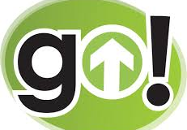
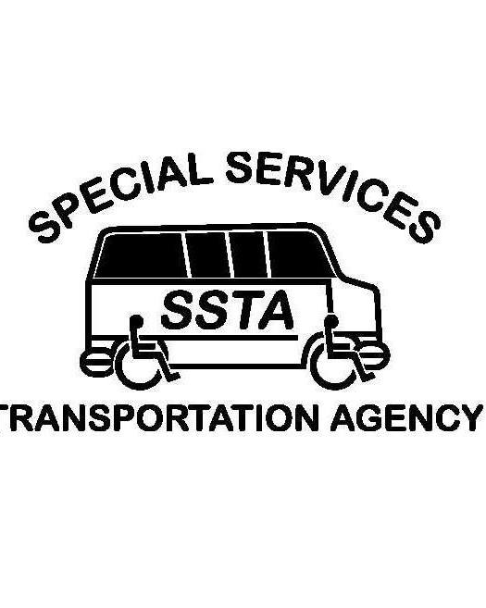
Specialized Transportation Services
Special Services Transportation Agency (SSTA)
Commute with Enterprise
CarShare Vermont
Notes:
Specialized transportation options help users access points of location that are not within a bus system, are rides outside of the times on a fixed bus route and/or are too far away to walk or bike to.
Overall, these transportation options seek to close the gap of accessibility when it comes to public transportation options.
SSTA:
SSTA is a paratransit service started in Chittenden County in 1982 with the goal to provide transportation services for people who have specialized mobility needs.
This service works by allowing users to book door to door rides 24-48 hours in advance for a small fee or donation.
Eligible riders are over the age of 60 or live with an ADA defined disability and the program is designed for folks who live ¾ of a mile from a bus stop (Vtrans, n.d). These rides can be used for a variety of activities such as medical care, meals, shopping, job interviews, employment, and leisure.
The program uses a combination of lift-equipped vans, sedans, minivans, along with volunteer drivers in their personal cars to operate, which increases the resilience of the program since there is more than one modality of service.
However, as noted by Councilman Bergman, there needs to be more of a monetary commitment from different stakeholders to subsidize this service throughout the state of Vermont so more individuals can access it.
I want to quickly touch on two other kinds of specialized transporation services. While they’re not targeted at an aging population, they can meet the needs of older folks getting to work As we re-intergrate older folk back into our workforce,
Commute with Enterprise:
An organization can request to implement this service at their workplace by committing at least five members (but up to 15) for a month-long trial run.
This service works by committing one person to be the driver of the vanpool, their responsibility being to pick up and drop off the other vanpool members on their route.
This initiative eliminates single occupancy vehicle use increases connectedness between co-workers and provides someone access with a car they can then use outside of working hours.
If an organization finds this initiative to be useful and working well for their employee population, they employees can share the cost of the vanpool which includes a gas card, an emergency roadside assistance service and vehicle maintenance vouchers. This transportation option is strong in the sense that it can be a cost-effective solution for employees to get to work and especially helpful for someone who does not have access to a personal vehicle (Connecting commuters, n.d).
Organizations that have used this resource have reported that not only did it provide a reliable transportation option, it also gave opportunity for employees to bond with one another, leading to a more positive work environment (INTERVIEW).
CarShare Vermont:
This organization uses a model that helps members access and share cars by allowing them to book cars on specific times and days.
The member then goes to the car pick up “pod” and can use the car for the full duration that they have requested.
Members pay a fee and pay a fixed amount per use based on mileage and gas prices and have access to roadside services, a gas card, and repair services included in their membership fee
Additionally, they offer income-based eligibility in the form of lower membership fee for qualifying applicants.
CarShare is a strong option for someone who does not own a car and would like to have one available to them when public transportation options do not meet their needs.

Slide 8
Final Recommendations & Areas of Growth
Indefinitely continue the free fare policy currently in place on public bus transport systems in Vermont
Encourage diversification of funding streams for the Burlington transportation system
Greater collaboration between stakeholders (Specialized Transport & UVMMC)
Third-Party Generational Transportation Assessment using participatory practices.
Notes:
We want to emphasize that Burlington's seniors are in the same age demographic but have diverse needs and abilities, so our recommendations are focused on several transit modalities in accordance with transportation demand management.
Green Mountain Transit is the largest bus system in VT, the free fare policy makes the biggest impact in Chittenden county. Next, we encourage the diversification of funding streams. Vermont cannot be reliant on federal funds such as American Rescue Plan Act and TIF bond that depend on the sitting president. We need to diversify funding across scales. Furthermore, the municipal bond was voted against in Burlington, this shows general hesitancy around raising taxes for Burlingtonians.
Next, we support greater collaboration between stakeholders as seen in other parts of the state. For example, Grace Cottage Family Health & Hospital has partnered with Green Mountain RSVP to recruit new volunteer drivers in the West River Valley and surrounding towns so that seniors can have improved access to medical appointments and wellness services in the Brattleboro area. This is a neighbor-to-neighbor assistance program can be adapted using specialized transportation services and major destinations like UVMMC. Transportation for medical rides is a top priority now as seniors attempt to live at home longer in life.
Our fourth recommendation is for the Burlington Aging Council to commission a generational transportation assessment using participatory practices. It's crucial to understand the needs of all demographics to prepare strategically for the ensuing generation of aging individuals.
FINISH
Finally, strategic investment in transportation can help overcome barrier by the BIPOC community, provide access to third places, and enable aging workers to re-enter the workforce. Tying together the problems earlier addressed by our peers, transportation is a keystone opportunity to address sustainability and accessibility in Burlington. Modernization of these structures could enable Burlington to be a model age-friendly community with the help and encouragement from Burlington Aging Council.

Slide 9
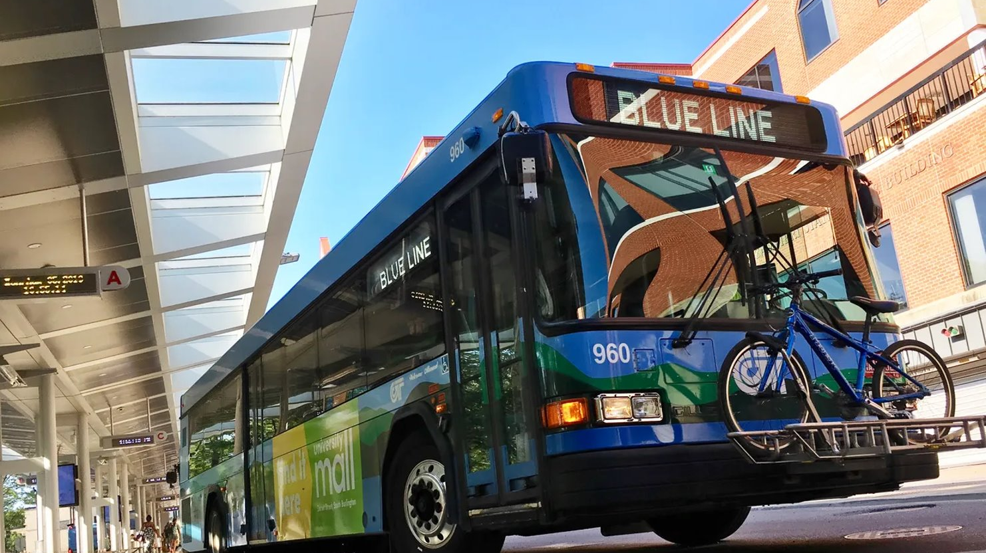
Council Questions and Insights

Slide 10
References
AARP Vermont. (2018, May). Burlington centennial neighborhood walk audit. AARP Vermont.https://www.healthvermont.gov/sites/default/files/documents/pdf/Burlington-Walk-Audit-Report-Final.pdf
American Public Transport Association. (n.d). A guide to multimodal transit. APTA Knowledge Hub. https://knowledgehub.apta.com/resource/transloc-a-guide-to-multimodal-transit?utm_source=apta&utm_medium=cast&utm_campaign=Recap040422
City of Burlington Public Works. (n.d.). Complete streets. City of Burlington, Vermont. Retrieved April 19, 2022, from https://www.burlingtonvt.gov/DPW/Complete-Streets
City of Burlington Public Works. (n.d). Great Streets BTV. http://greatstreetsbtv.com/downtown-standards
Faste, Trygve and Muenchinger, Kiersten. Design for an Aging Population. NITC-ED-986. Portland, OR: Transportation Research and Education Center (TREC), 2017.
Mobility Lab. (2012) What is TDM? Mobility Lab. https://mobilitylab.org/about-us/what-is-tdm/
RSG, CATMA (2015). City of Burlington Transportation Demand Management Action Plan. Retrieved April 19, 2022, from https://parkburlington.com/wp-content/uploads/2014/09/BTV_TDM_ActionPlan_20151016.pdf
Walk Bike Master Plan Burlington, Vermont. (2017, March 17). City of Burlington. Retrieved April 19, 2022, from https://www.burlingtonvt.gov/sites/default/files/PlanBTVWalkBike_MasterPlan_finalPlanOnly.pdf
Walk Friendly Communities. (n.d). Burlington, Vermont. Walk Friendly Communities. https://www.walkfriendly.org/communities/burlington-vt/

