Slide 1
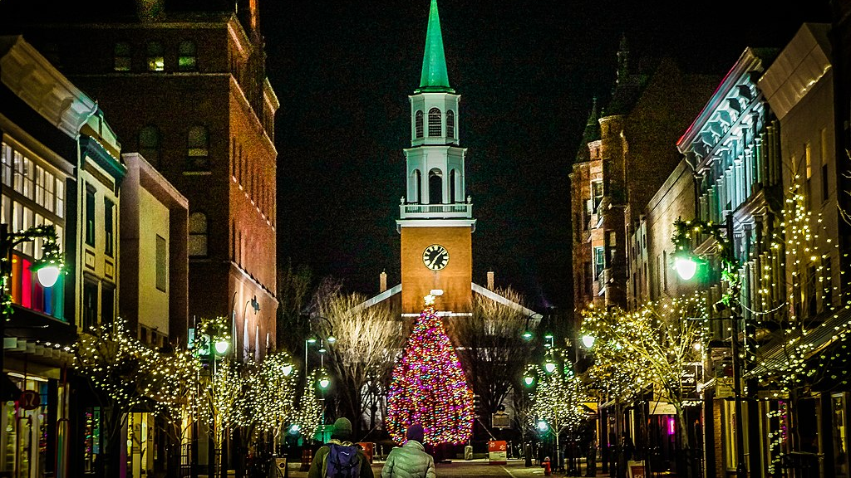
Communications Strategy Accessing Information
What are best practices in communicating with and engaging older residents in a small city like Burlington?
Katie McGrath, Noah Gilbert-Fuller, Maddie Russell, and Sydney Hinckley
This Photo by Unknown author is licensed under CC BY-SA.

Slide 2
In Our Report We:
Discuss goals and impact of communications strategies
Detail our project research methods
Document research findings related to:
Communications tools
Market trends
Language accessibility and translation
Importance of third spaces for accessing information
Provide recommendations including the implementation of a seniors' newsletter

Slide 3
Tools and Design
Multiple levels of communication
Both print and digital media
Most effective strategies:
Seniors’ newsletter
Community directory
Outreach at natural gathering places
Outreach via professionals / volunteers

Slide 4
Marketing Strategies and Trends
Email use growth
Opportunities in direct mail advertising
Coupons are a highly favored tactic
Coupon use benefits local businesses
Findings can be used to appeal to local partners

Slide 5
Language Translation and Accessibility
The Model Practices Framework for Health Communication describes the various components in having effective communication with immigrants, refugees, and migrant workers¹. These include:
Identifying Trusted Leaders
Marrying Stories with Data
Keeping Relationships and Presence Paramount
Building and Maintaining Trust
Prioritizing a Collaboration that Endures
Formal | Informal | Diverse
Auditory Interpretation Translated Documents Partner with Organizations Public Policy Develop a Coalition Statewide (Vermont Language Justice Project) | Multimedia Social Media (WhatsApp, Zoom, Facebook Messenger and more) Third Spaces Relationship Building | 14% of people in Burlington speak a language other than English at home Consider Literacy (Maay Maay) Multipronged Approach
Notes:
[1] Health Communication with Immigrants, Refugees, and Migrant Workers: Proceedings of a Workshop—in Brief. Health and Medicine Division; National Academies of Sciences, Engineering, and Medicine. Washington (DC): National Academies Press (US); 2017 Jun 2.

Slide 6
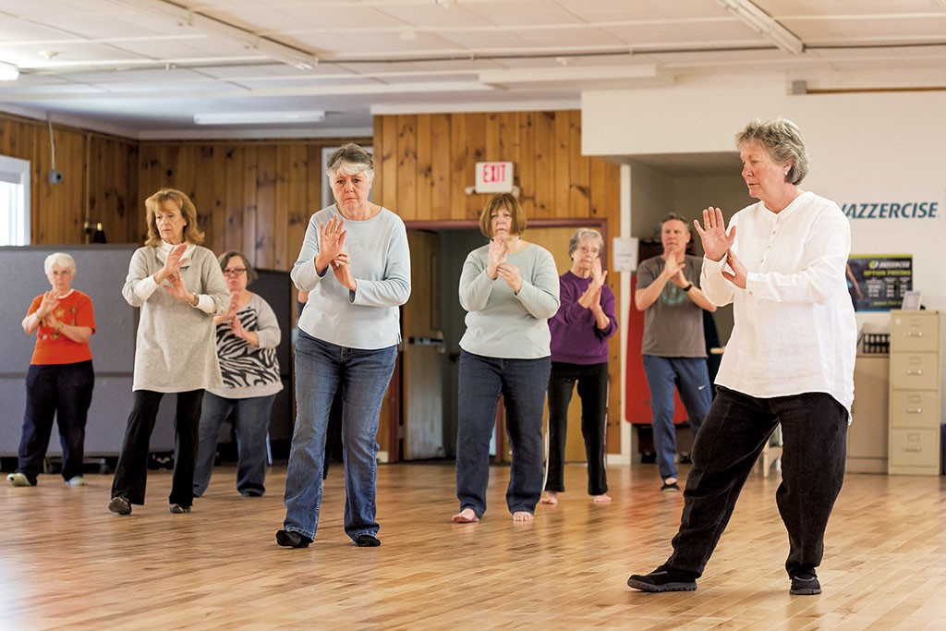
Third Spaces
Includes:
Volunteer organizations
Educational institutions
Clubs and hobby groups
Senior centers
Religious institutions
Third Spaces offer networking opportunities to reach groups of senior Burlington residents.
Print and Email are often used to contact senior members of these organizations.
Leaders contacted indicated that one-to-one communications (in-person, over-the-phone) often work best in educating members on new methods of communication

Slide 7
Advancing a Communications Strategy
Business Partnerships: Coupons and local deals to generate buy in. Potential partnership with the Church Street Marketplace Commision and/or Local First Vermont
Translation services: Newsletter disseminated in multiple languages to improve accessibility. Multiple options for translation
Readership Engagement: "We want to hear from you" section in newsletter
Proposal: A dual-platform newsletter to disseminate resources to Burlington's older residents, offered in both email or snail mail format
Promotion: Opt-in model. Advertised through social media, newspapers, radio stations, word of mouth, third place flyering
Content Development: Potential partnership with UVM Public Communication program

Slide 8
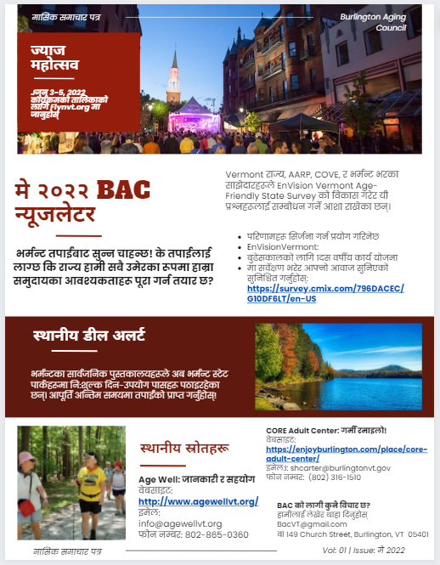
Nepali Translated Sample:
Opportunity for community engagement
Project that community needs the reader's help on
Local deal/value add
Useful local resources for the aging population
Opportunity for readership engagement

Slide 9
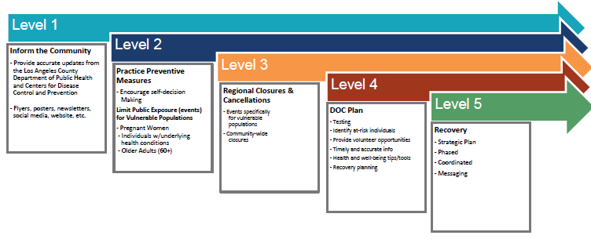
Mechanics of Implementation
1. Assessment of Local Resources
Audit
Communications Network Map
2. Partner with Other Cities
3. Tiers
4. Cost of Implementation
Texts & Social Media
SMS and Third Spaces

Slide 10
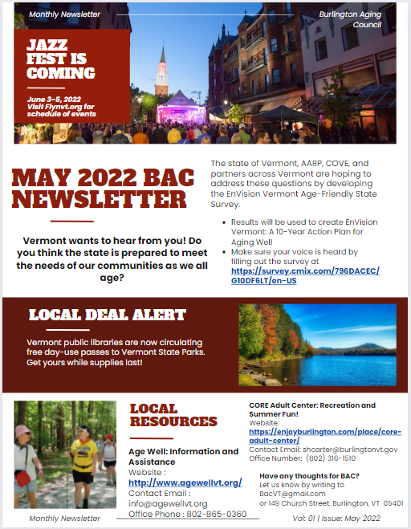
Conclusion and Next Steps
Dual-platform Newsletter proposed to disseminate resources, since there is evidence that older residents react positively to both direct mail and email advertising.
Next Steps:
Reach out to UVM's PCOM program
Partner with Third Places
Plan physical and virtual distribution
Expand two-way communication with seniors
Engage translation services
Establish metrics to measure success

