Slide 1

The Neighborhood Project (TNP)
June 13th, 2018
Gillian Nanton
Community & Economic Development Office

Slide 2
Background to The Neighborhood Project (TNP)
- Part of Eagles Landing settlement agreement
- Champlain College agreed to work with City, UVM and Preservation Burlington to create a neighborhood stabilization program (TNP)
- Residents of near-campus areas were calling for a pro-active strategy to support QoL improvements in City’s historic neighborhoods

Slide 3
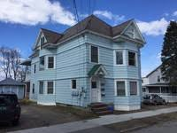
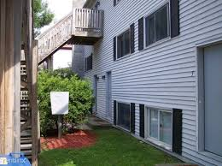

TNP Goals:
Identify potential strategies and tools for neighborhood stabilization to create opportunities for a diversity of housing choices in near-campus neighborhoods
Improve the quality of housing stock for a wide range of residents
Identify quality of life initiatives to support residents

Slide 4
TNP - one of 22 proposals
in HAP aimed at more affordable
housing and livability in the city
Residents of neighborhoods
impacted by heavy student
populations called for a
pro-active NSP (TNP)

Slide 5
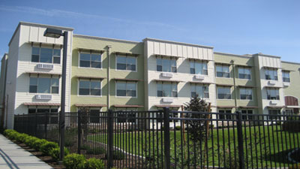
City identified availability & affordability of housing as one of its most significant challenges
HAP identified lack of sufficient housing as negatively impacting quality of life
Overtime the City has pursued strategies to address quality of life challenges: e.g.
Minimum Rental Housing Ord.
Noise Ordinance
4-Unrelated zoning provision
Agreements between City & institutions around housing
UVM & Champlain College – host of programs aimed at improving QoL

Slide 6
TNP Consultants’ Tasks:
Create datasets and analyze neighborhood trends (demographics, student renter housing, real estate/market trends, QoL)
Research best practices in peer communities
Stakeholder consultations (extensive interviews with residents, property owners, students, developers, institutions, realtors, city staff etc.)
Neighborhood tours of study area (Wards 1, 2, 6 & 8)
Recommend strategies and tools that City and partners could consider to address neighborhood stabilization

Slide 7
Geographic focus:
                RFP asked consultants to study
near-campus neighborhoods
(Wards 1, 2, 6 and 8. Ward 3
was also studied)
                Through an evaluation of background
information and community conversations, an area was identified >>25% >25% of residents are students

Slide 8
TNP Process:
Interviews and site tours – 60 interviews, site tours (Wards 1, 2, 6, & 8)
Input from interviews and tours was used to identify key issues and informed the approach to the analysis of other types of data
Interpreting datasets from the City, institutions, Census and other sources
Preliminary discussion with key implementers to vet variety of strategies so ideas brought forward were viable options to consider

Slide 9
TNP Process
Community Open House – December 2017
Community Survey – December 2017 – February 2018
Funding Partners/Steering Committee – Project Partners provided guidance throughout the project

Slide 10
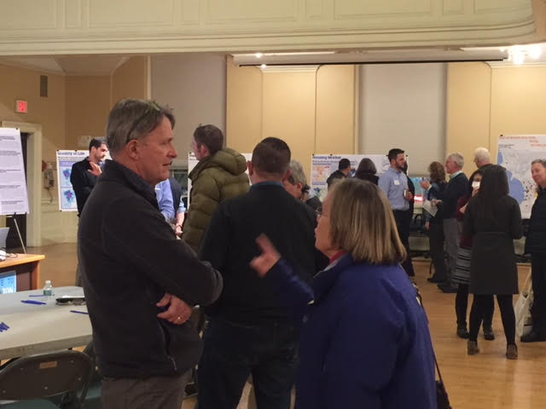
TNP findings organized around three overarching areas:
Neighborhood Trends
Quality of Life
Housing Dynamics

Slide 11
Key Findings:
More campus supported housing that ever before, but rental housing located in areas with concentration of historic properties
Some anecdotal evidence student renters becoming more prevalent on streets that were traditional owner-occupied, single family
Burlington has a number of best practices in place; QoL trends heading in positive direction. However, potential expansion of rental housing for students outside this area could cause issues

Slide 12
Key findings:
Changes in life stage status is creating a housing dynamic that is putting single family housing on the market adjacent to campus and areas where there are student renters. Areas adjacent to campus owing to high rents could lead investors to purchase homes and convert them to investment rentals
Historic neighborhoods east of downtown which have a higher density of student renters also have the highest density of people in the city. These historic neighborhoods not designed for current lifestyles. Also higher cost to restore/preserve these properties

Slide 13
Percentage of population ages Areas with highest propensity
50-64 by Census Block Group to change

Slide 14
Key findings:
Based on interviews and follow-up conversations, there’re key mis-understandings regarding regulations, pre-existing non-conforming conditions, and zoning/planning requirements covering a range of issues for these neighborhoods

Slide 15
Two major conclusions:
Areas predominantly occupied by student renters have been student neighborhoods for several decades. Housing stock reflects long-standing use which creates challenges for re-habilitation and/or conversion to owner-occupied and/or longer-term rental housing
The spread of student rentals can be managed somewhat through regulatory processes, but a more permanent solution requires a combination of new, dedicated student housing supply paired with a targeted acquisition strategy to make properties available as owner-occupied housing, as potential properties become available over time.

Slide 16
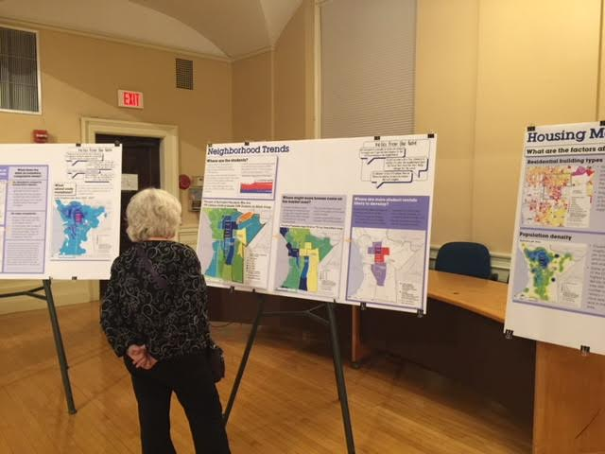
3 potential strategies, each with proposed actions:
Enhance quality of life initiatives
Contain & slow down conversions of single family homes to rentals
Convert selected primarily student rental properties to non-student housing while maintaining affordability

Slide 17
#1 Enhance quality of life initiatives
Clarify, simplify and communicate the City’s existing quality of life tools, building on successful efforts
Review of ‘fair warning’ policies (QoL ordinances, enforcement mechanisms or resulting penalties for violations. Consider whether a toolkit may serve as a ‘first notice’ or ‘warning’ of these responsibilities and whether a first offense should carry a more serious penalty)
Build on current renter education program
Examine strategies to better manage demand for parking in neighborhoods
Provide additional police presence after bars close
Use data to track results and enhance quality of life efforts

Slide 18
#2 Contain conversion of single family homes to rentals
Create more student housing on or near campuses (UVM explore Trinity Campus)
Encourage higher density development/redevelopment in appropriate areas
Institute an employer assisted housing program
Create a property acquisition fund to acquire single family homes in or near the study Wards to maintain owner-occupancy
Enable modest infill development/redevelopment in keeping with zoning regulations
Enhance livability standards

Slide 19
#3 Convert selected primarily student rental properties to non-student housing
Create a fund to acquire what have been primarily student rental properties to maintain owner occupancy
Institute an employer assisted housing program
Create a targeted rehab loan program
Clarify ‘Housing Unit Replacement’ Ordinance when reducing number of housing units
Target program funds for rehab of owner occupied historic properties that may otherwise be unable to comply with historic standards.

Slide 20
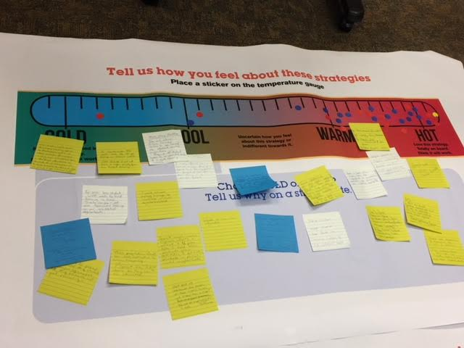
Feedback on proposed strategies:
Mixed reaction; support for many of the ideas, but there’s a need to focus on landlord and institutions’ responsibilities in managing students and additional actions beyond just addressing QoL issues
Most participants supportive of containing and slowing down conversions of single family homes to rentals
Some support for conversion of student rentals to non-student housing

Slide 21
So what comes next?
June 2018
Wards 1 and 8 NPA Meeting – June 13th
Public Workshop - Consultant presents draft report – June 25, SD Ireland Bldg, Champlain College, 12:00 noon – 2:00 p.m.
Public Meeting – Consultant presents draft report - June 26, Contois Auditorium, 5:30 p.m. – 7:30 p.m.
Report presented to CDNR Committee or City Council – July/Aug 2018

Slide 22
Questions?
Participant Addresses

