Slide 1

Workshop
THE NEIGHBORHOOD PROJECT
June 25, 2018
Presented by

Slide 2
Project Goals

Slide 3
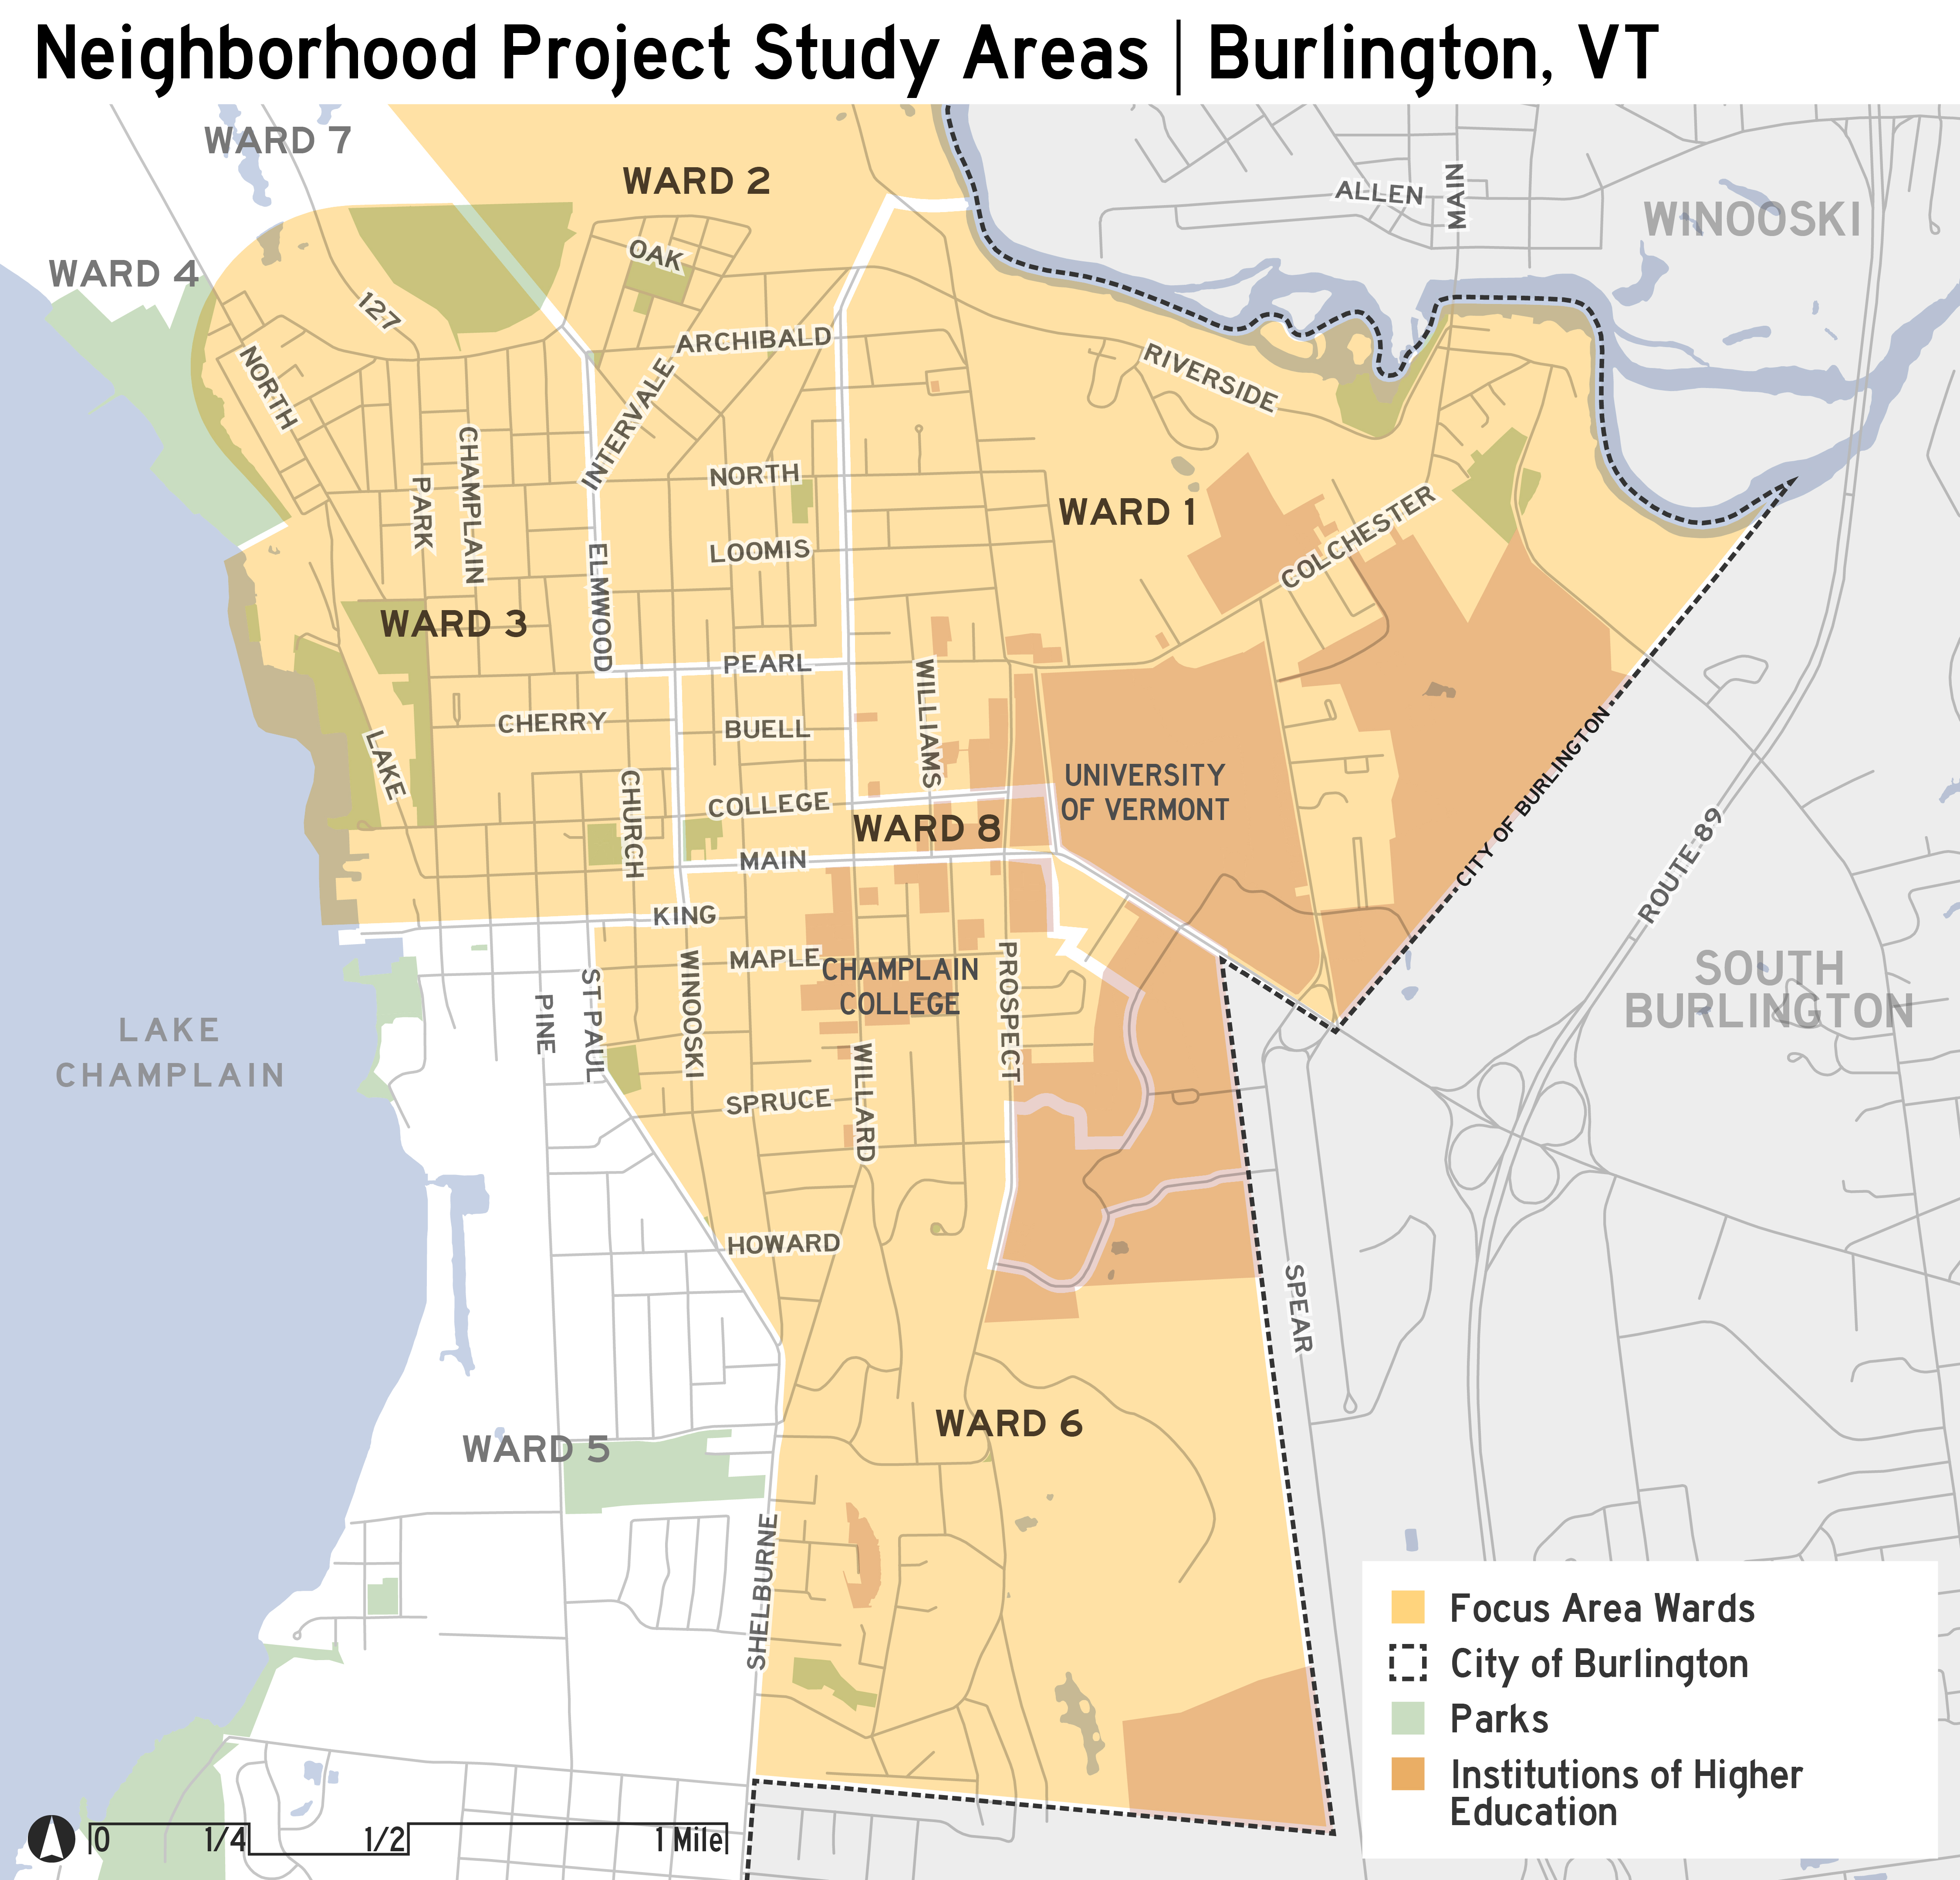
Project goals
To understand what’s happening in the neighborhoods most affected by rentals where students tend to live.
To inform a community discussion about what “neighborhood balance” is and how to improve the quality of life in the neighborhoods most impacted.
To identify specific, practical actions the City and its partners can and are willing to take.

Slide 4
What We Learned and What It Means

Slide 5
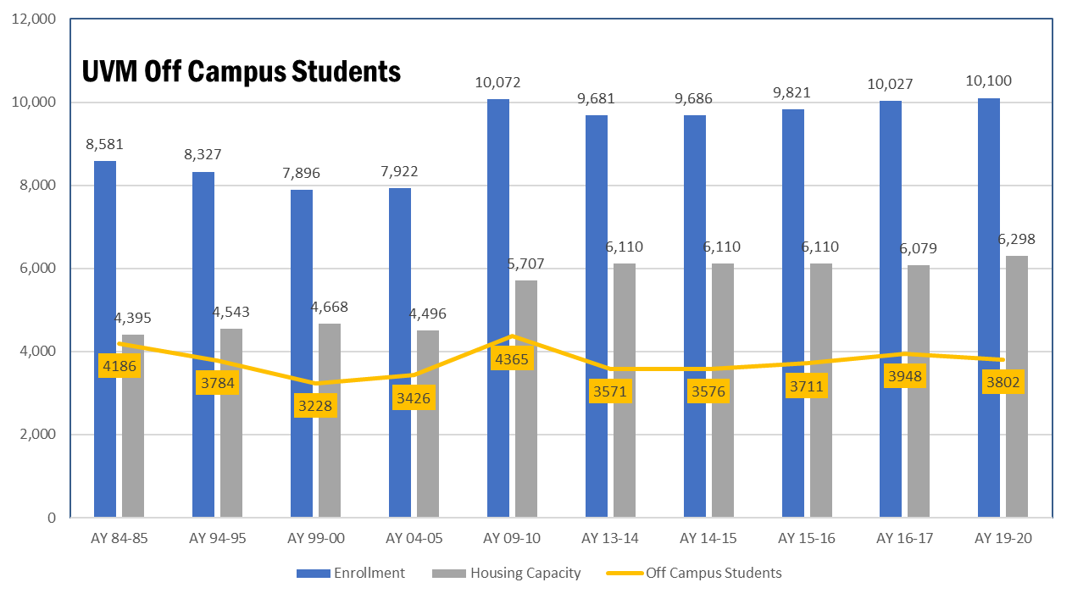
More on campus housing but off campus student expansion
There is more campus supported student housing than ever before, but rental
housing predominantly occupied by student renters is located in areas with
a high concentration of historic properties and student renters might become
more prevalent on streets that were traditionally owner-occupied, single-family homes.

Slide 6
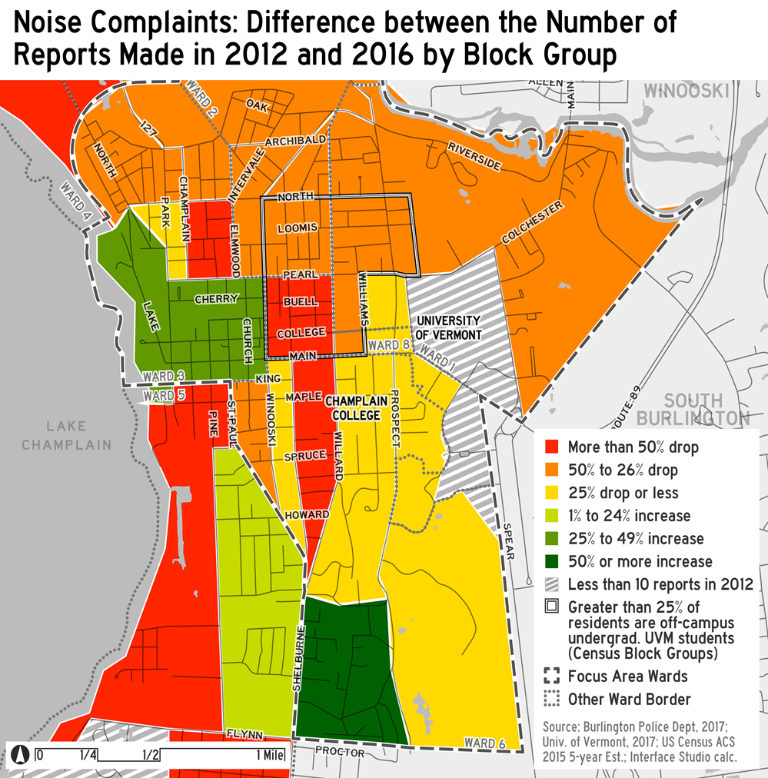
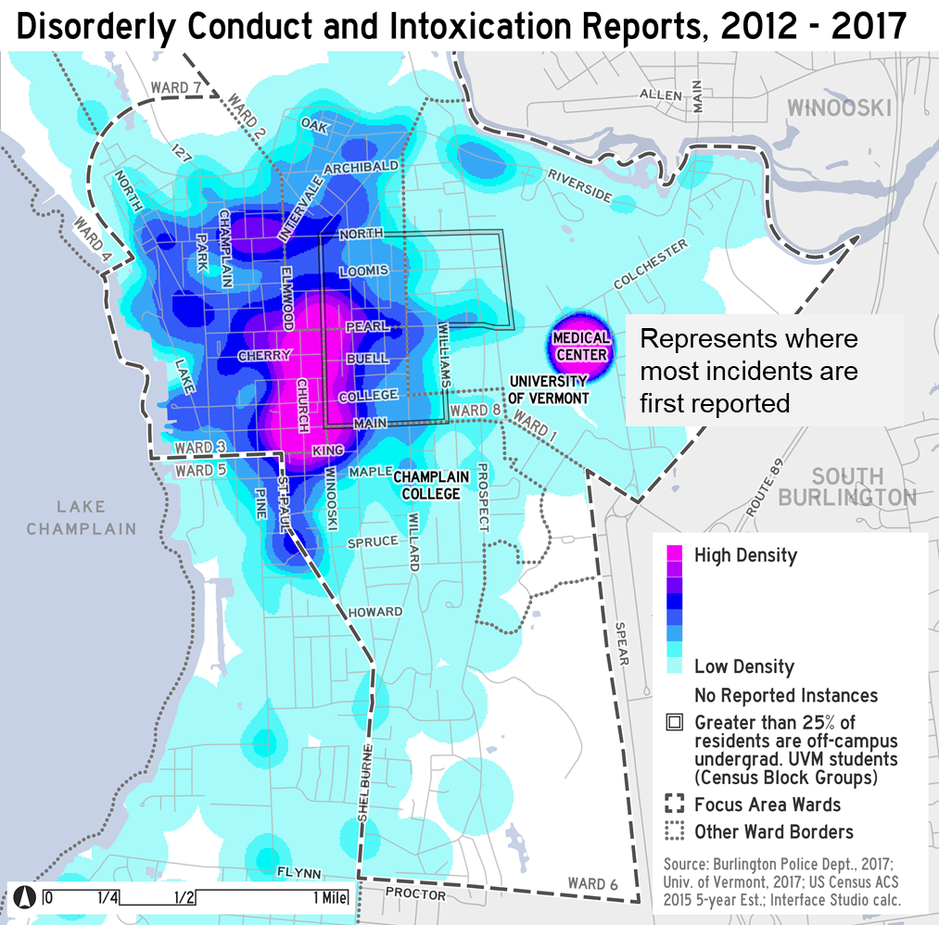
Quality of life best practices and positive trends but larger geography introduces new areas to impacts
Burlington has a number of best practices in place relative to addressing off-campus student impacts.
Quality of life trends in areas historically occupied by students are heading in a positive direction; however, expansion of rental housing for students outside of this area may cause issues in new parts of
the city.
Moreover, increased downtown living by non-students may contribute to complaint levels based on proximity to entertainment centers of Burlington.

Slide 7
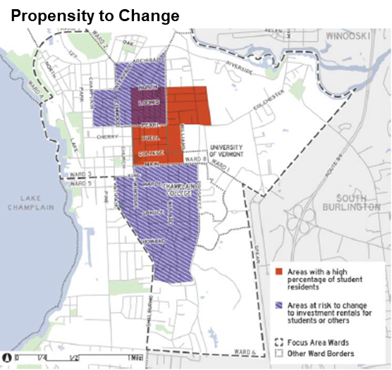
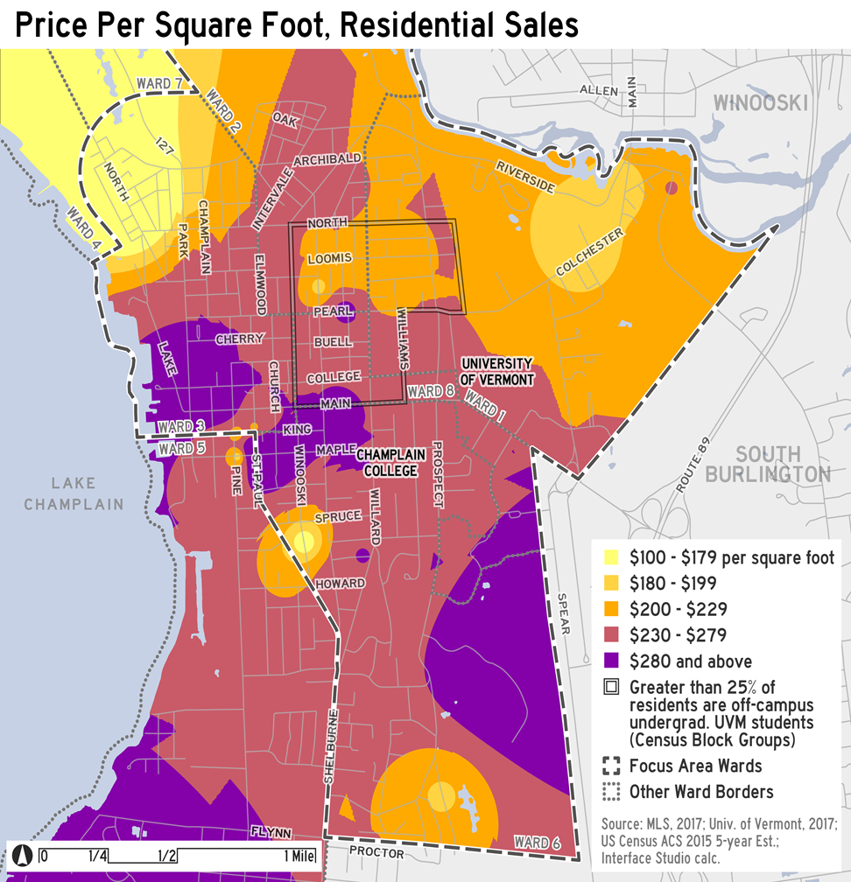
Underlying housing dynamics are problematic
The changes in life stage status among the city’s urban core residents is creating a housing dynamic that is putting single family housing on the market adjacent to campus and student areas.
Housing price points are high, but
roughly consistent with price points in the core of the city.
However, there are areas adjacent to campus that can generate rental income contributing to asset price appreciation and conversions of single family housing to rentals for students or others.

Slide 8
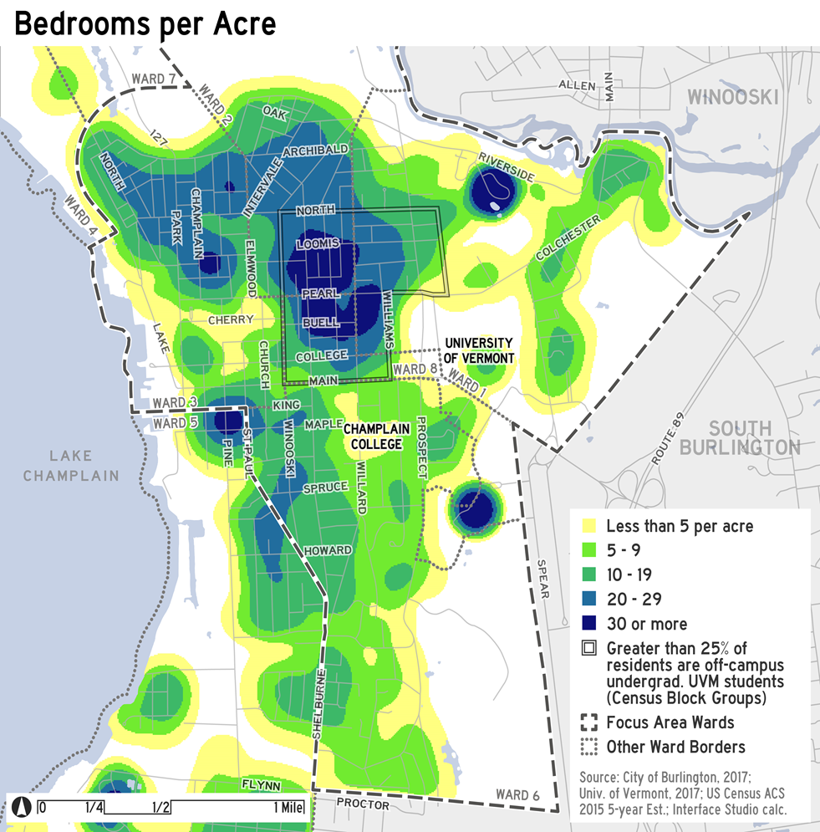
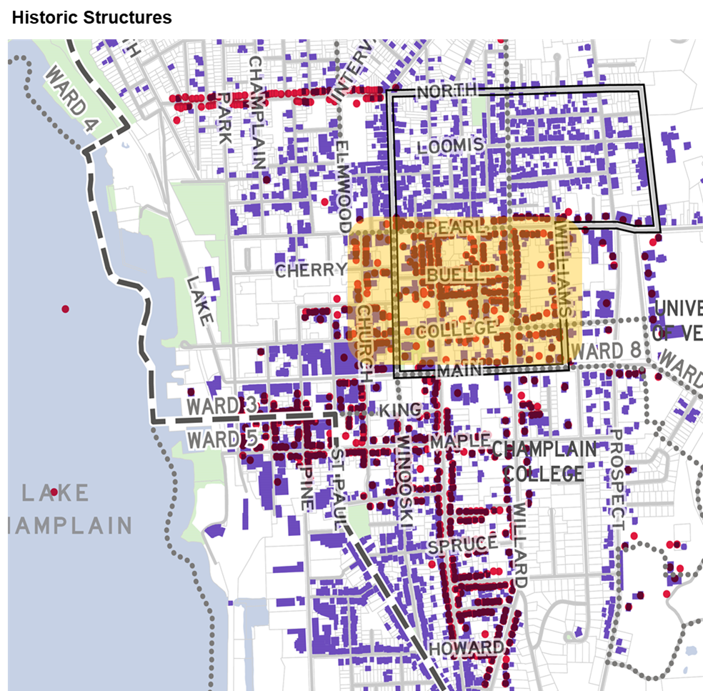
Burlington has greater people density in its core
The areas with higher density of student renters also have the highest people
density in the city and are located in
historic neighborhoods east of downtown, suggesting the carrying capacity of
this area may be challenged to meet the lifestyle and mobility requirements
of the level of density now located in it.
It also raises concerns about the
ability to preserve and/or restore these historic properties.

Slide 9
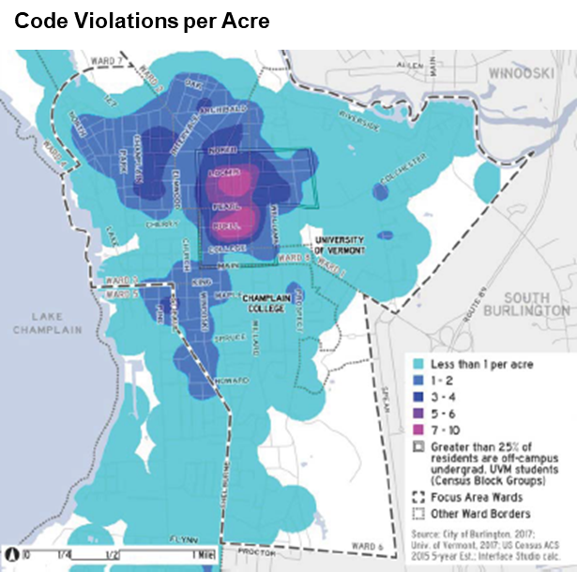
Misunderstanding regarding rules and requirements
Our interviews and follow up conversations revealed key misunderstandings regarding regulations, pre-existing non-conforming conditions, and zoning/ planning requirements covering a range of issues for these neighborhoods.

Slide 10
Major conclusions
#1: Areas predominantly occupied by student renters have been student neighborhoods for several decades now. The housing stock in these areas reflect this long standing use, which create challenges for rehabilitation and/ or conversion to owner-occupied and/or longer-term rental housing.
#2: The spread of student rentals can be managed somewhat through
regulatory processes, but a more permanent solution requires a combination of new, dedicated student housing supply (with appropriate amenities) paired with a targeted acquisition strategy to make properties available as owner-occupied housing, as potential properties become available over time.

Slide 11
It’s going to take time to rebalance the neighborhoods – there is no perfect solution – the longer it takes looking for “perfect” makes the problem harder and more expensive to solve – therefore doing nothing is also a decision

Slide 12

Neighborhood Project Strategy Framework
Enhance Quality of Life Initiatives
Contain & Slow Down Conversion of Single Family Homes
Convert Selected Student Rentals to Non Student Residential while Maintaining Affordability
WHY THIS:
These can have an immediate or near term impact on some of the issues and help set stage for later actions. Also these are in the immediate control of the partners in this process.
WHY THIS:
Major challenge going forward is potential continued geographic expansion of rentals where students may live into traditionally single family neighborhoods because of changing demographics
Actions that impact the market incentives for this conversion can help manage this dynamic.
WHY THIS:
Most student rentals will require extensive rehab to be brought back for use as housing for broad range for Burlington residents. However, lease status, costs of acquisition and the rehab costs makes this prohibitive for many considering this as a primary residence.
Consideration will need to be given to which housing can be brought back based on its location and rehab costs.

Slide 13
Specific
Action Items

Slide 14
Neighborhood Project Strategy Framework
Enhance Quality of Life Initiatives
Contain & Slow Down Conversion of Single Family Homes
Convert Selected Student Rentals to Non Student Residential while Maintaining Affordability
Clarify, simplify, and communicate the City’s existing quality of life tools, building on successful efforts
Review of “fair warning” policies
Build on current renter education program
Implement strategies to better manage demand for parking in core neighborhoods
Provide additional police presence after bars close
Use data to track results and enhance quality of life efforts
Create more student housing on or near campuses
Encourage higher density development/redevelopment in
appropriate areas
Institute an employer assisted housing program
Create a property acquisition fund to acquire single family
homes in or near the study Wards to maintain owner-occupancy
Enable modest infill development/redevelopment in keeping with zoning regulations
Enhance livability standards
Create a fund to acquire what have been primarily student
rental properties
Institute an employer assisted housing program
Create a targeted rehab loan program
Clarify ‘Housing Unit Replacement’ Ordinance when reducing number of housing units
Target program funds for rehab of owner occupied historic properties that may otherwise be unable to comply with historic standards

Slide 15
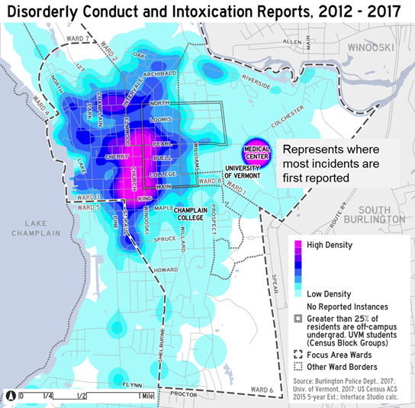
Enhance quality of life initiatives
Clarify, simplify, and communicate the City’s existing quality of life tools
Review “fair warning” policies
  E.g., should 1st offenses carry stiffer penalties?
Provide additional after bar closing police presence
Build on current renter education programs
  E.g., provide information kits to all renters in Burlington about their rights and responsibilities
Implement strategies to better manage demand for parking in core neighborhoods
  E.g., expanded bike share / car share programs

Slide 16
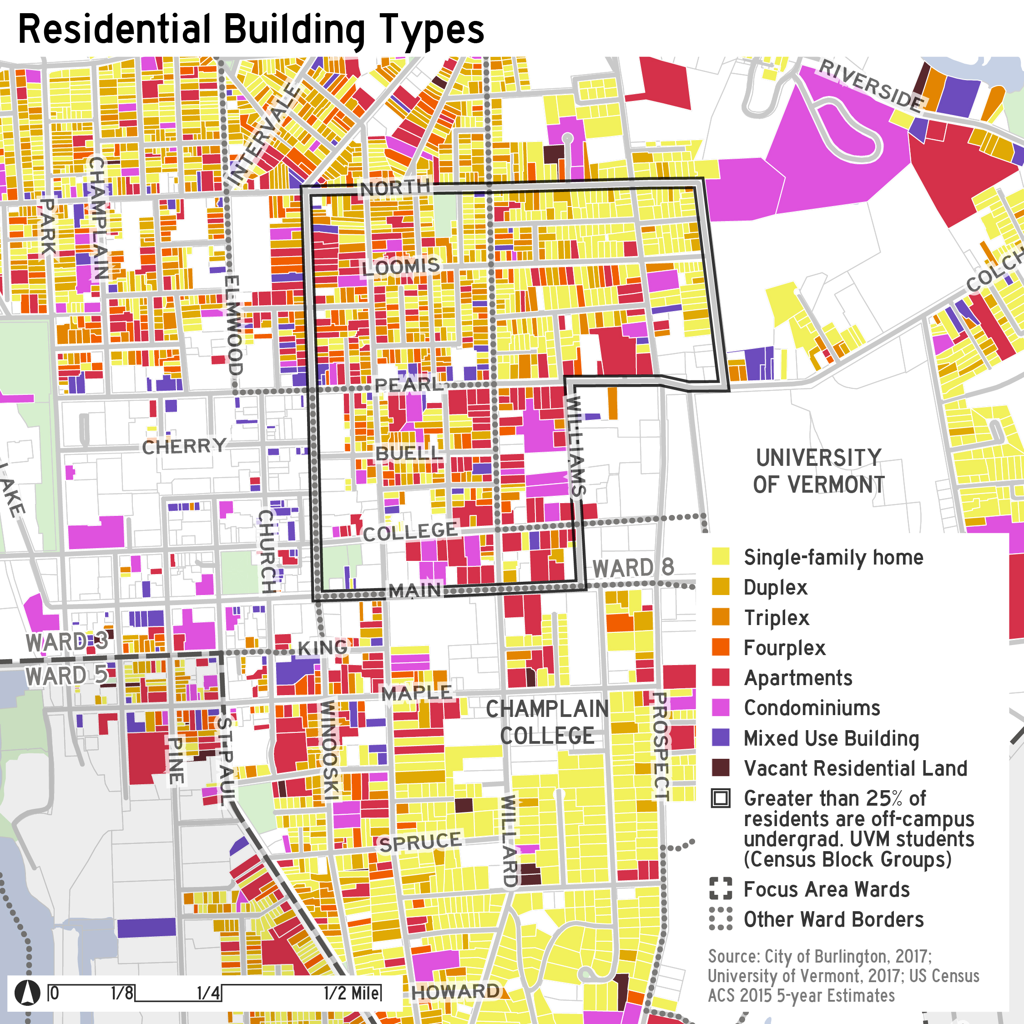
Contain and slow down conversion of single family homes
Create more student housing on or adjacent to campuses:
Encourage higher density development/redevelopment in appropriate areas:
  E.g. Target density to where the infrastructure can handle it
Institute an employer assisted housing program:
  E.g. down payment or closing cost assistance
Create a property acquisition fund to acquire single family homes:
  E.g., to compete against investor-buyers, funded by private, institutional and public monies
Enable modest infill:
Codify livability standards:
  E.g., Bathrooms to bedroom ratios

Slide 17
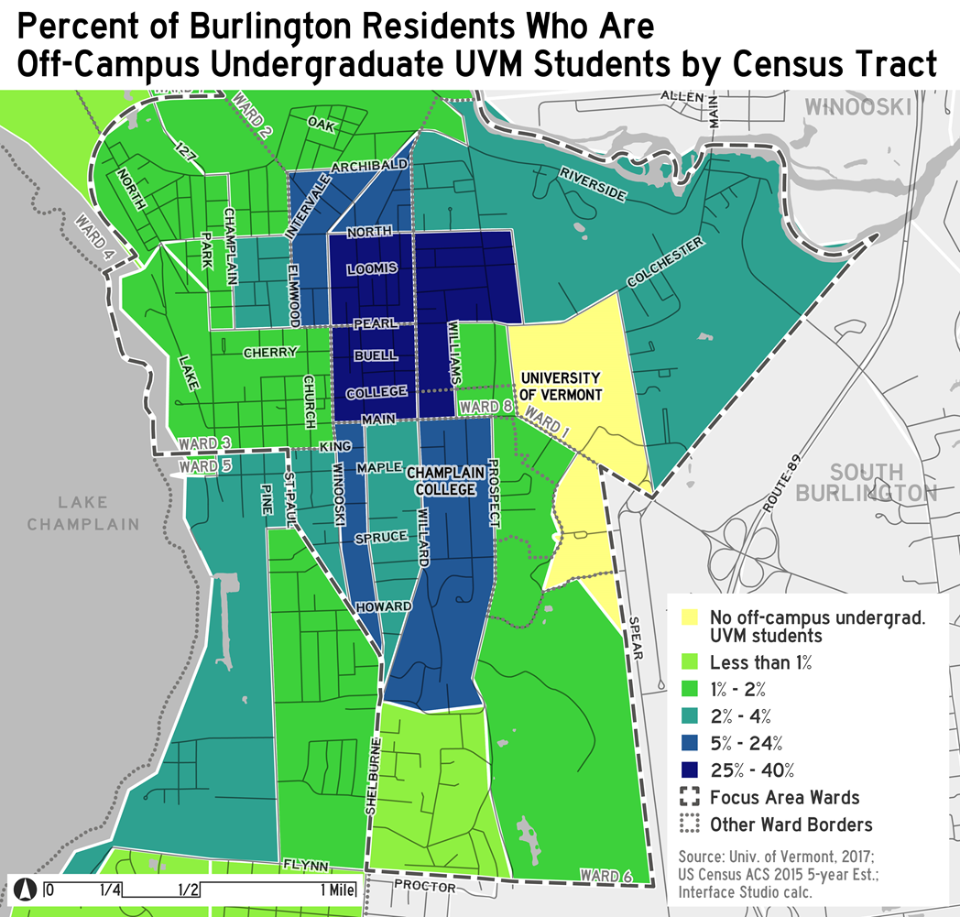
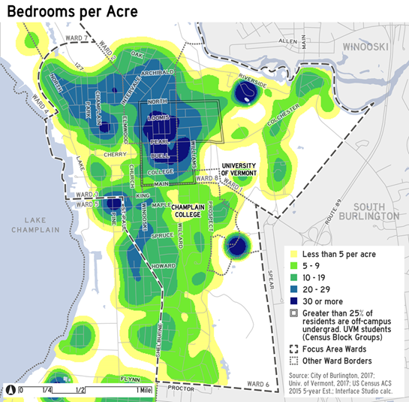
Convert Selected Student Rentals to Non Student Residential while Maintaining Affordability
Create a fund to acquire student rental properties:
Institute an employer assisted housing program:
  E.g., forgiveable loan for rehab in designated neighborhoods
Create a targeted rehab loan program:
  E.g,, created by working with a local financial institution
Clarify “Housing Unit Replacement” Ordinance as it applies to the conversion of existing housing:
Target program funds for rehab of owner occupied historic properties that may otherwise be unable to comply with historic standards:
  E.g., potentially modeled after Conservation Legacy Fund

Slide 18
Most of these initiatives particularly the ones where financing programs are required are still conceptual, some require partners to come to participate (employer assisted housing) nor would all initiatives apply to every ward – the objective is to provide the city, its academic partners, and housing/preservation community with a diverse toolkit to respond as conditions warrant – we need your help in prioritizing where to focus ongoing efforts

Slide 19
Community Feedback

Slide 20
Measuring Reactions to recommended strategies through the temperature gauge
The Project used a temperature gauge to get
people’s reactions, which had the following options:
HOT = (Love this strategy. Totally on board. Think it will work.)
WARM = (Like this strategy. Think there are some good ideas in there.)
UNCERTAIN = (not sure how you feel about this strategy or indifferent towards it.)
COOL = (Have some questions about this strategy before I can be
supportive of it.)
COLD = (Not at all interested in this strategy. Needs a lot more work.)

Slide 21
QUALITY OF LIFE INITIATIVES FEEDBACK
Summary of Commentary
Several participants noted that these types of actions have not been successful in their experience or their belief that on their own these actions cannot make signiﬁcant change. Others wondered what role would the schools play in reducing the number of cars brought to Burlington.

Slide 22
Contain and slow down conversions
Summary of Commentary
Most comments regarded the details behind how these programs would work, the sources of money, the impact on the housing market particularly would it drive down valuations, and whether deed restrictions would be desirable over the long term.

Slide 23
Convert select properties back to owner occupied
Summary of Commentary
The comments on this strategy echoed the comments pertaining to containing and slowing down the conversion of single family homes. Most comments regarded the details behind how these programs would work, the sources of money, the impact on the housing market particularly would it drive down valuations, and whether deed restrictions would be desirable over the long term.

Slide 24
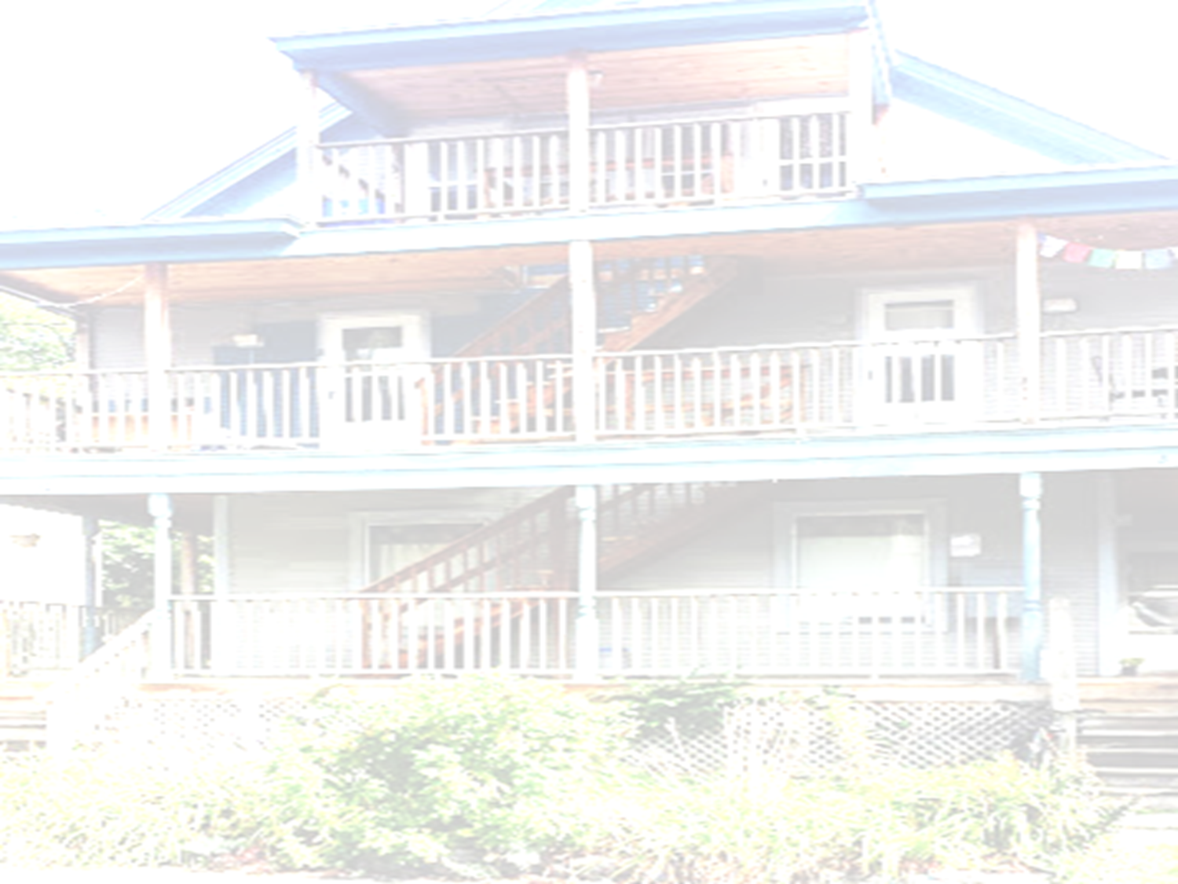
Thank You

