Slide 1
The Neighborhood Project (TNP) (An Update)
May 8, 2019
Gillian Nanton
Community & Economic Development Office
Presentation to: Wards 1& 8 NPAs

Slide 2
TNP Goal: To develop an actionable strategy and toolkit of policies for neighborhood stabilization
TNP - one of 22 proposals in HAP
Residents of neighborhoods impacted by heavy student populations called for a pro-active Neighborhood Stabilization Program (TNP)
Notes:
TNP – Partnership between UVM, Champlain College, Preservation Burlington & City
TNP – Toolkit of policies – Help with diversity of housing choices; improve housing stock; QoL

Slide 3
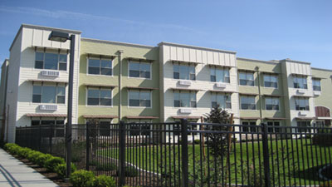
City identified availability & affordability of housing as one of its most significant challenges
HAP identified lack of sufficient housing as negatively impacting quality of life
Overtime the City has pursued strategies to address quality of life challenges: e.g.
Minimum Rental Housing Ord.
Noise Ordinance
4-Unrelated zoning provision
Agreements between City & institutions around housing
UVM & Champlain College – host of programs aimed at improving QoL

Slide 4
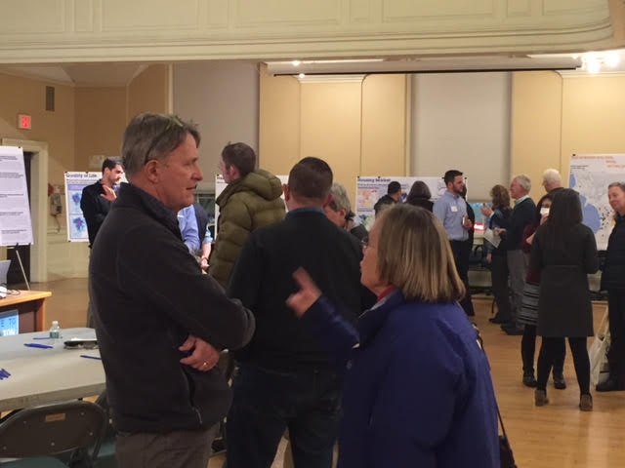
TNP Approach
60 interviews
Neighborhood tours (Wards 1,2,6, 8)
Mapped a series of data sets
3 Workshops and Community
Open House with 85 attendees
Online survey with 179 respondents

Slide 5
Present State of Student Housing
Approximately 3,100 undergraduate students live off-
campus in Burlington, of which ~ 94% (2,800-2,900) are
UVM students.
UVM off-campus students have decreased from 49% of total enrollment in Academic Year 1984- 85 to 39% in Academic Year 2016-17. The off campus student population peaked in 2010.
There is some anecdotal evidence that student renters are becoming more prevalent on streets that were traditionally owner-occupied, single-family homes
Please note “Off Campus” in this figure
includes UVM students living at home, or in other communities in Vermont or the region
Notes:
Highest concentration of students - North and Main Streets and Winooski Ave & Campus

Slide 6
Quality of Life Best Practices and Positive Trends, but larger geography introduces new areas to impact
Burlington has a number of best practices
in place relative to addressing off-campus student impacts.
Quality of life trends in areas historically
occupied by students are heading in a positive direction (drop in noise complaints & disorderly conduct and intoxication reports); however, expansion of rental housing for students outside of this area may cause issues in new parts of
the city.
Moreover, increased downtown living by non-students could contribute to complaint levels based on proximity to entertainment centers of Burlington
Notes:
Note: During 2012-2017, Church St. and nearby areas generated the most reports of disorderly conduct and intoxication.

Slide 7
Underlying Housing Dynamics are Problematic
The changes in life stage status among the
city’s urban core residents is creating a housing dynamic that is putting single family housing on the market adjacent to campus and student areas.
Housing price points in near-campus neighborhoods are high, but roughly consistent with price points in the core of the city, making it extremely difficult for a new family to afford.
As a result, single family homes adjacent to campus are targets for conversion to investment rentals for students or others.
Notes:
Shaded area: Higher percentage of homeowners (demographics) at an age where they are likely to sell their home owing to downsizing or changing housing needs.

Slide 8
Burlington has greater people density in its core
The areas with higher density of student renters also have the highest people density in the city (city-wide ~ 5.7 bedrooms per acre) and are located in historic neighborhoods east of downtown, suggesting the carrying capacity of this area may be challenged to meet the lifestyle and mobility requirements of the level of density now located in it.
It also raises concerns about the
ability to preserve and/or restore these historic properties.
Note: As of 2016, Burlington had just over 1,000 nationally designated historic properties and 14 nationally designated historic districts.
Notes:
Bedrooms per acre tells how many people are living in an area. City-wide roughly 5.7 bedrooms per acre, on average. Some areas with highest bedroom density fall within highest student renter area - 30 or more bedrooms per acres.
Burlington has stricter standards for historic buildings; often historic renovation requires costly building materials.

Slide 9
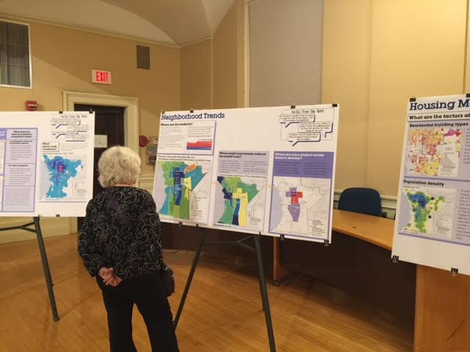
Misunderstanding Regarding Rules and Requirements
The consulting team through interviews and follow-up conversations revealed key misunderstandings regarding regulations, pre-existing non-conforming conditions, and zoning/planning requirements covering a range of issues for these neighborhoods

Slide 10
Major Conclusions
# 1. Areas predominantly occupied by student renters have been
student neighborhoods for several decades now. The housing stock
in these areas reflect this long standing use, which create
challenges for rehabilitation and/or conversion to owner-occupied
and/or longer-term rental housing.
#2. The spread of student rentals can be managed somewhat through regulatory processes, but a more permanent solution requires a combination of new, dedicated student housing supply (with appropriate amenities) paired with a targeted acquisition strategy to make properties available as owner-occupied housing, as potential properties become available over time.

Slide 11
It’s going to take time to rebalance the neighborhoods – there is no perfect solution – the longer it takes looking for “perfect” makes the problem harder and more expensive to solve – therefore doing nothing is also a decision

Slide 12
Neighborhood Project Strategy Framework
Enhance Quality of Life Initiatives
Contain & Slow Down Conversion of Single Family Homes
Convert Selected Student Housing to Non Student Residential while Maintaining Affordability
WHY THIS:
WHY THIS:
WHY THIS:
These can have an immediate or near term impact on some of the issues and help set the stage for later actions. Also these are in the immediate control of the partners in this process
Major challenge going forward is potential continued geographic expansion of all campus student housing into traditionally single family neighborhoods because of changing demographics.
Actions that impact the market incentives for this conversion can help manage this dynamic
Most student housing will require extensive rehab to be brought back for use as housing for board range for Burlington residents. However, lease status, cost of acquisition and the rehab costs makes this prohibitive for many considering this as a primary residents.
Consideration will need to be given to which housing can be brought back based on location and rehab costs.

Slide 13
Neighborhood Project Strategy Framework
Enhance Quality of Life Initiatives
Contain & Slow Down Conversion of Single Family Homes
Convert Selected Student Housing to Non Student Residential while Maintaining Affordability
Clarify, simplify and communicate the City’s existing quality of life tools, building on successful efforts
Review of “fair warning” policies
Build on current renter education program
Implement strategies to management demand for parking in core neighborhoods
Provide additional police presence after bars close
Create more student housing on or near campuses
Encourage higher density development/redevelopment in appropriate areas
Institute an employer assisted housing program
Create a property acquisition fund to acquire single family homes in or near the study Wards to maintain owner occupancy
Enable modest infill development/redevelopment in keeping with zoning regs
Enhance livability standards
Create a fund to acquire what have been primarily student rental properties
Institute an employer assisted housing program
Create a targeted rehab loan program
Clarify ‘Housing Unit Replacement’ Ordinance when reducing number of housing units
Target program funds for rehab of owner occupied historic properties that may otherwise be unable to comply with historic standards

Slide 14
COMMUNITY FEEDBACK

Slide 15
Workshop
Survey
Response %
Hot 17%
Warm 47%
Uncertain 7%
Cool 27%
Cold 14%
Hot Warm Uncertain Cool Cold
Response %
Hot 11%
Warm 50%
Uncertain 5%
Cool 21%
Cold 13%
Hot Warm Uncertain Cool Cold
21

Slide 16
Workshop
Survey
Response %
Hot 32%
Warm 33%
Uncertain 5%
Cool 18%
Cold 12%
Hot Warm Uncertain Cool Cold
Response %
Hot 27%
Warm 33%
Uncertain 6%
Cool 20%
Cold 14%
Hot Warm Uncertain Cool Cold
22

Slide 17
Workshop
Survey
Response %
Hot 34%
Warm 29%
Uncertain 13%
Cool 13%
Cold 12%
Hot Warm Uncertain Cool Cold
Response %
Hot 30%
Warm 30%
Uncertain 34%
Cool 16%
Cold 10%
Hot Warm Uncertain Cool Cold
23

Slide 18
Most of these initiatives particularly the ones where financing programs are required are still conceptual, some require partners to come to participate (employer assisted housing) nor would all initiatives apply to every ward – the objective of the TNP is to provide the city, its academic partners, and housing/preservation community with a diverse toolkit to respond as conditions warrant – we need your help in continuing to prioritize where to focus ongoing efforts

Slide 19
So What Comes Next?
On April 29, the City Council unanimously accepted The Neighborhood Project report and referred it to the Community Development and Neighborhood Revitalization (CDNR) Committee.
CDNR Committee has been requested to review the Report’s recommendations and to prioritize actions and develop a plan and timeframe for taking these forward.
The CDNR Committee is to report back to the City Council by end of July 2019.

Slide 20
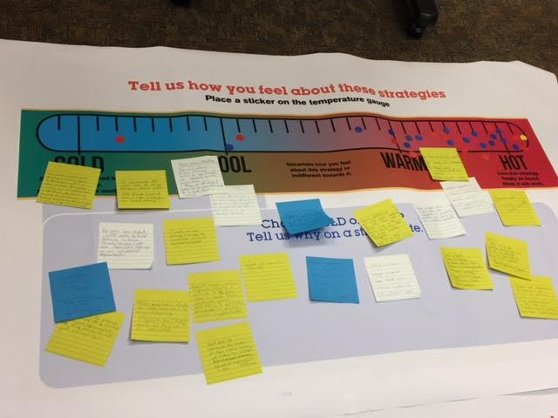
Thank You

